Slide 1




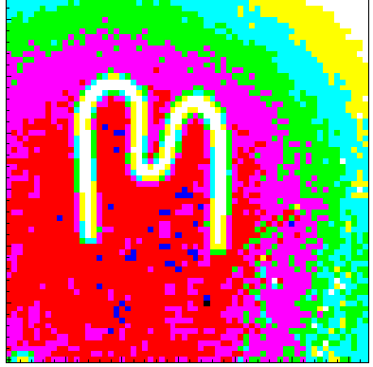
Spatial and Time Correlated Detection of the Decay Chain of Radioactive Nuclei
Carlos Granja, Jan Jakubek, Michal Platkevic, Stanislav Pospisil
Institute of Experimental and Applied Physics
Czech Technical University in Prague
Ulli Köster
Institute Laue Langevin ILL, Grenoble, France
Research with pixel detector in frame of the Medipix Collaboration

Slide 2
Outline
www.cern.ch/medipix
IEAP CTU + 2.5 MeV VdG accelerator
Radiation imaging (X-ray phase contrast, n imaging)
Radiation detection & nuclear spectroscopy
  Fission fragment spectroscopy (correlations & angular distributions)
  Separation of nuclear reaction (charged particle) products at solenoid focal plane
Position sensitive hybrid pixel detectors Medipix
  Per–pixel energy– and time– sensitive Timepix device
  Timepix + USB readout interface + Pixelman SW → Portable Radiation Camera
Spatial– and time– correlated detection of radioactive nuclei
  Event-by-event RO [TIM mode + ext trigger]
    Charged particle decay chain ⁸He → ⁸Li → ⁸Be → 2α
  High count rate: extended shutter [TOT mode + trigger ext clock]
    Radioactive isomer & isomer decay (IC e’s): ^{98m}Y
Future (registration of short-lived (µs–s) decay of n rich radioactive nuclei)

Slide 3
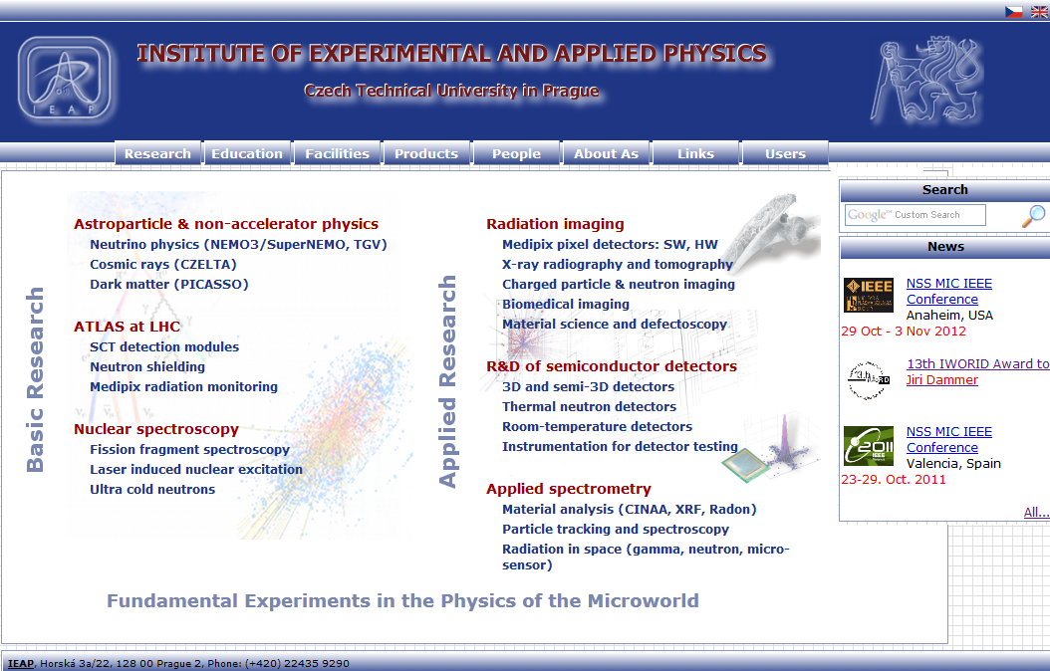
www.utef.cvut.cz

Slide 4
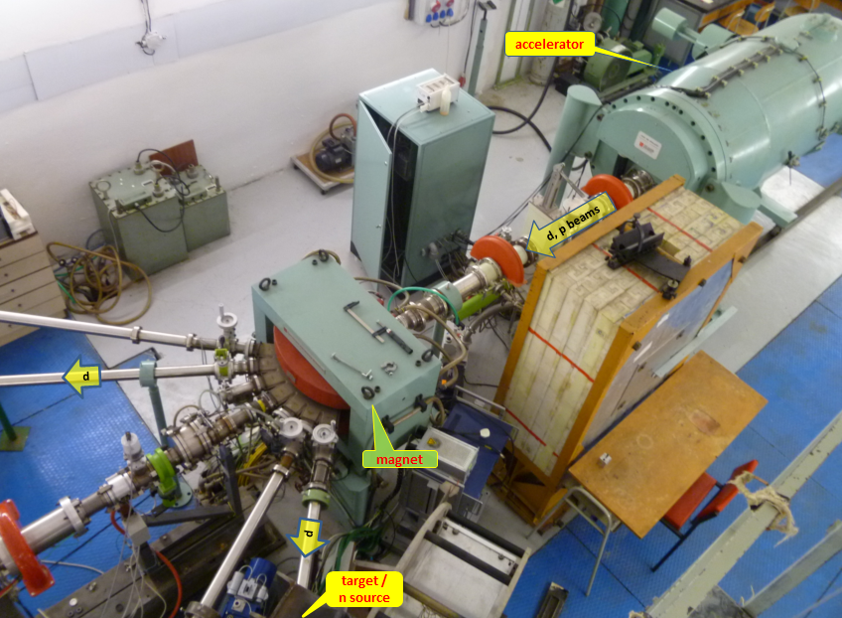
2.5 MeV VdG at IEAP CTU in Prague
E = 0.3 – 2.5 MeV; I = 0.5-50 µA
p,d,⁴He; ³He (future)
n (qm & monochromatic 40-60 keV, 4 MeV,15 MeV)

Slide 5
Radiation Imaging Detectors
Jan Jakůbek, IEAP CTU Prague
Film emulsions change of chemical or physical properties after interaction with radiation. Needs special treatment (developing process, scanning, …).
Charge integrating devices
Ionizing radiation creates charge which is collected and integrated in pixels (CCD, CMOS sensors, Flat panels, …)
Particle counting pixel detectors
Ionizing radiation creates charge which is compared with threshold and counted digitally in pixels
+
+
+
Very high resolution
Low noise
Cheap
High spatial resolution
Low price
Good spatial resolution
High read-out speed
No noise, no dark current
–
–
+
Nonlinear response
Limited dynamic scale
Needs processing
Dark current
Noise
Limited dynamic scale
Linear response
Wide (unlimited) dynamic
range/contrast

Slide 6
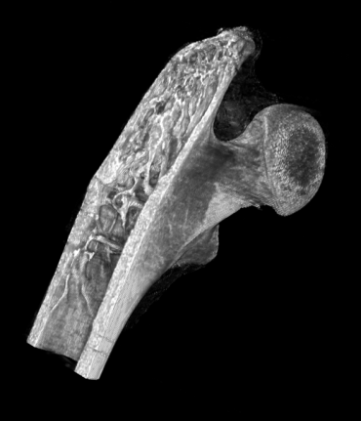
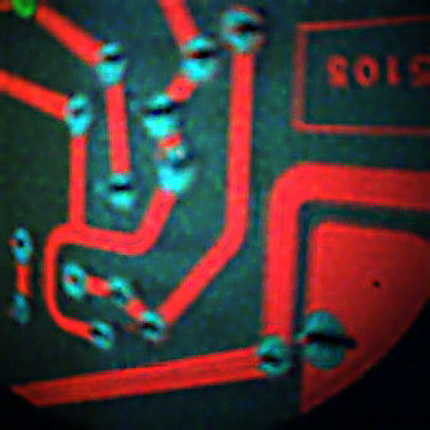
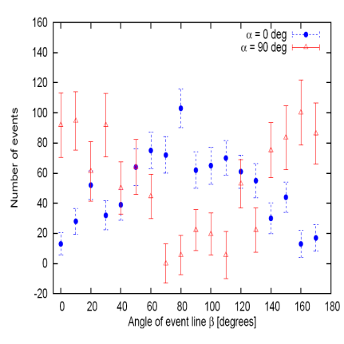
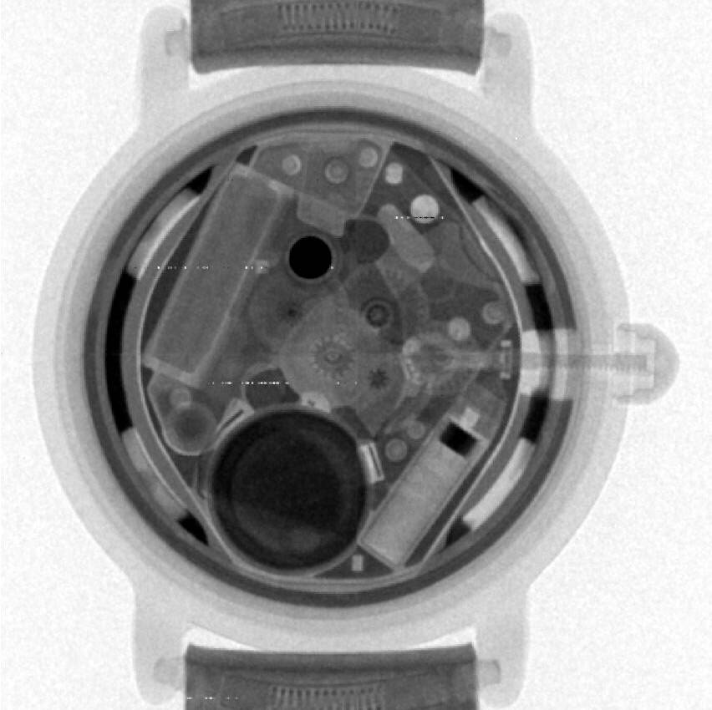
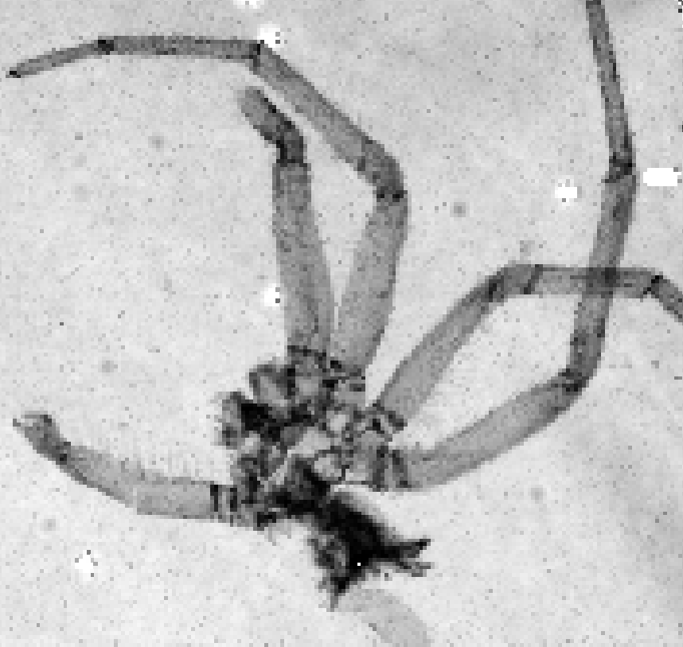
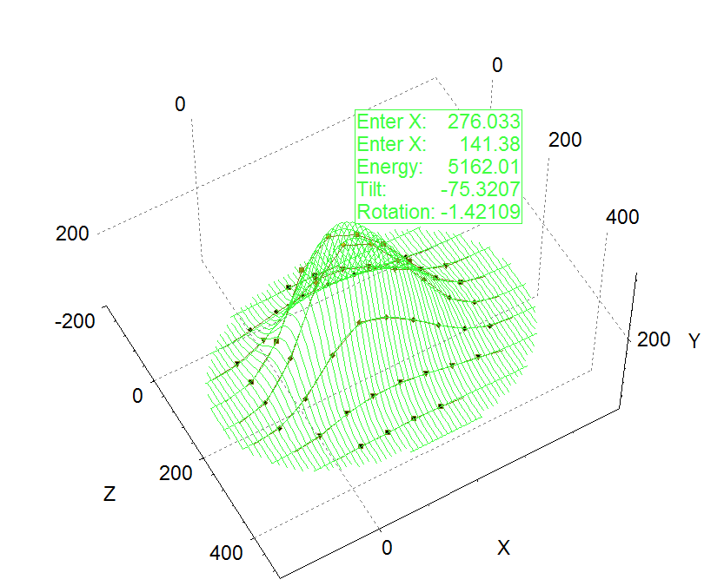
Applications: Radiation Imaging
Jan Jakůbek, IEAP CTU Prague
X-rays: intensity
X-rays: energy
X-rays: phase
X-rays: polarization
30 μm
1 mm
Neutrons: intensity
Neutrons: energy
Ions: energy
Ions: direction
Area of transmission

Slide 7
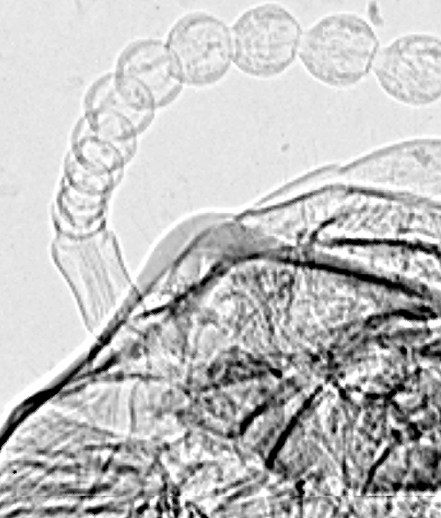
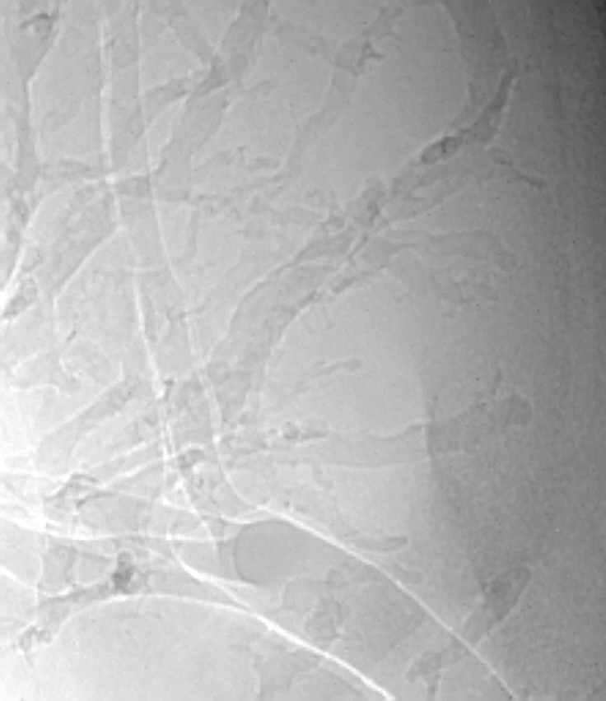
X-ray phase contrast imaging:
Edges are enhanced in radiograms
Jan Jakůbek, IEAP CTU Prague
100 um
Edges are enhanced
by phase effects
Termite head
Mouse Kidney
ILL Grenoble 25th April 2007
Notes:
7
Next, we used the detector medipix for imaging of animal tissue. In this picture we concentrated (konsentreit) on mouse kidneys. We were looking for presence of tumors in mouse kydney. The first picture presents the kidney without tumor cells. Also you can see different magnification. We clearly observe (ebzerv) the inside structure of kidney.

Slide 8
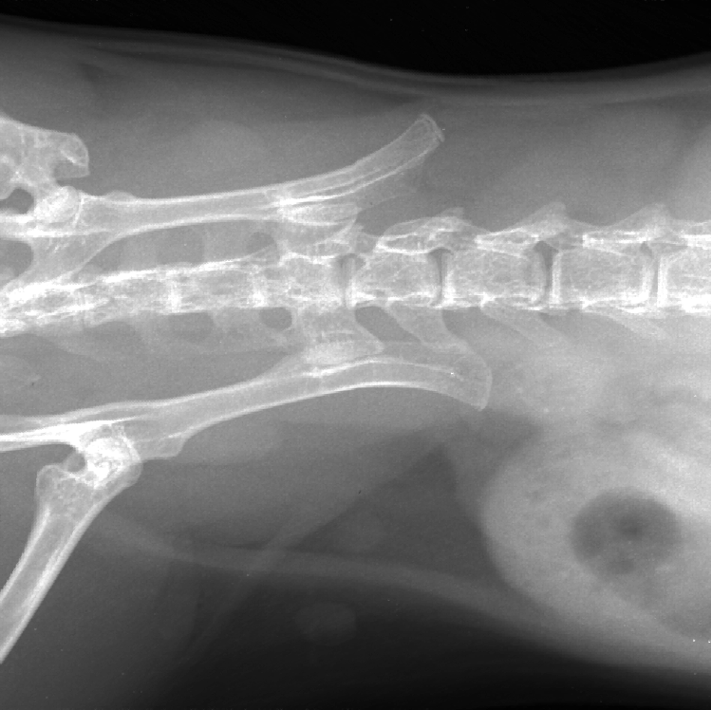

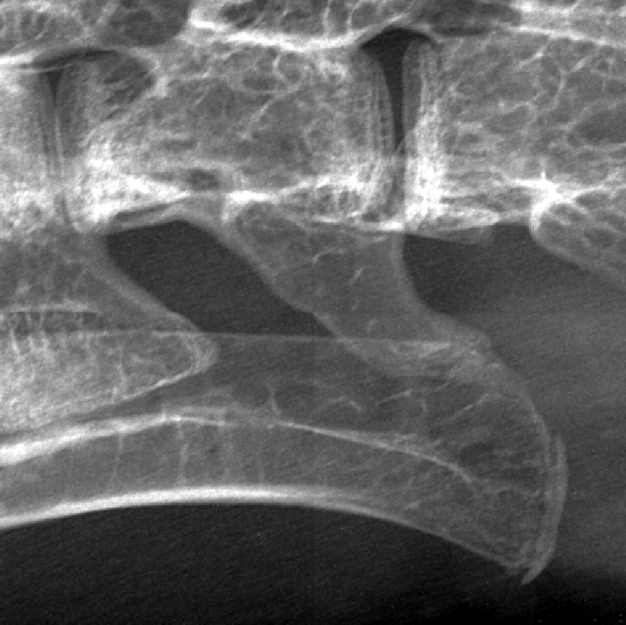
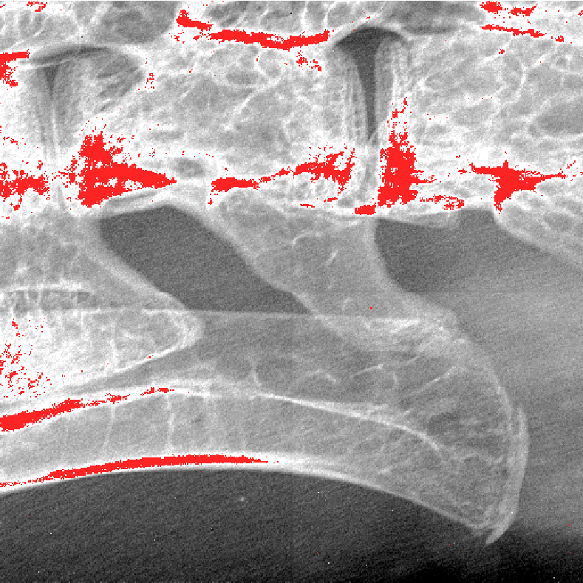

Primary Application: High contrast imaging
Mouse backbone and pelvis
Jan Jakůbek, IEAP CTU Prague
In-vivo imaging
Very light objects resolved (hairs)
Strange textured noise
Bone structure nicely imaged
Soft tissue organs well recognized
Not a noise:
We can resolve individual hair fibers through the mouse body !

Slide 9
Position Sensitive
Fission Fragment Spectroscopy
Quaternary fission
“True” Quaternary Fission
“Pseudo” Quaternary Fission
α
HF
LF
HF
LF
⁸Be
α
α
α
search for other rare decay modes in fission – e.g. quinary fission (¹²C* → α+α+α), collinear fission.
Measurement of angular and energy distributions and spatial correlations of ternary and quaternary particles.
.Determination of quaternary fission yields with high accuracy and sensitivity
Direct observation of ⁸Be emission as a ternary particle in the ground and excited state
Search for other rare decay modes in fission – e.g. quinary fission (¹²C* → α+α+α), Collinear fission?

Slide 10

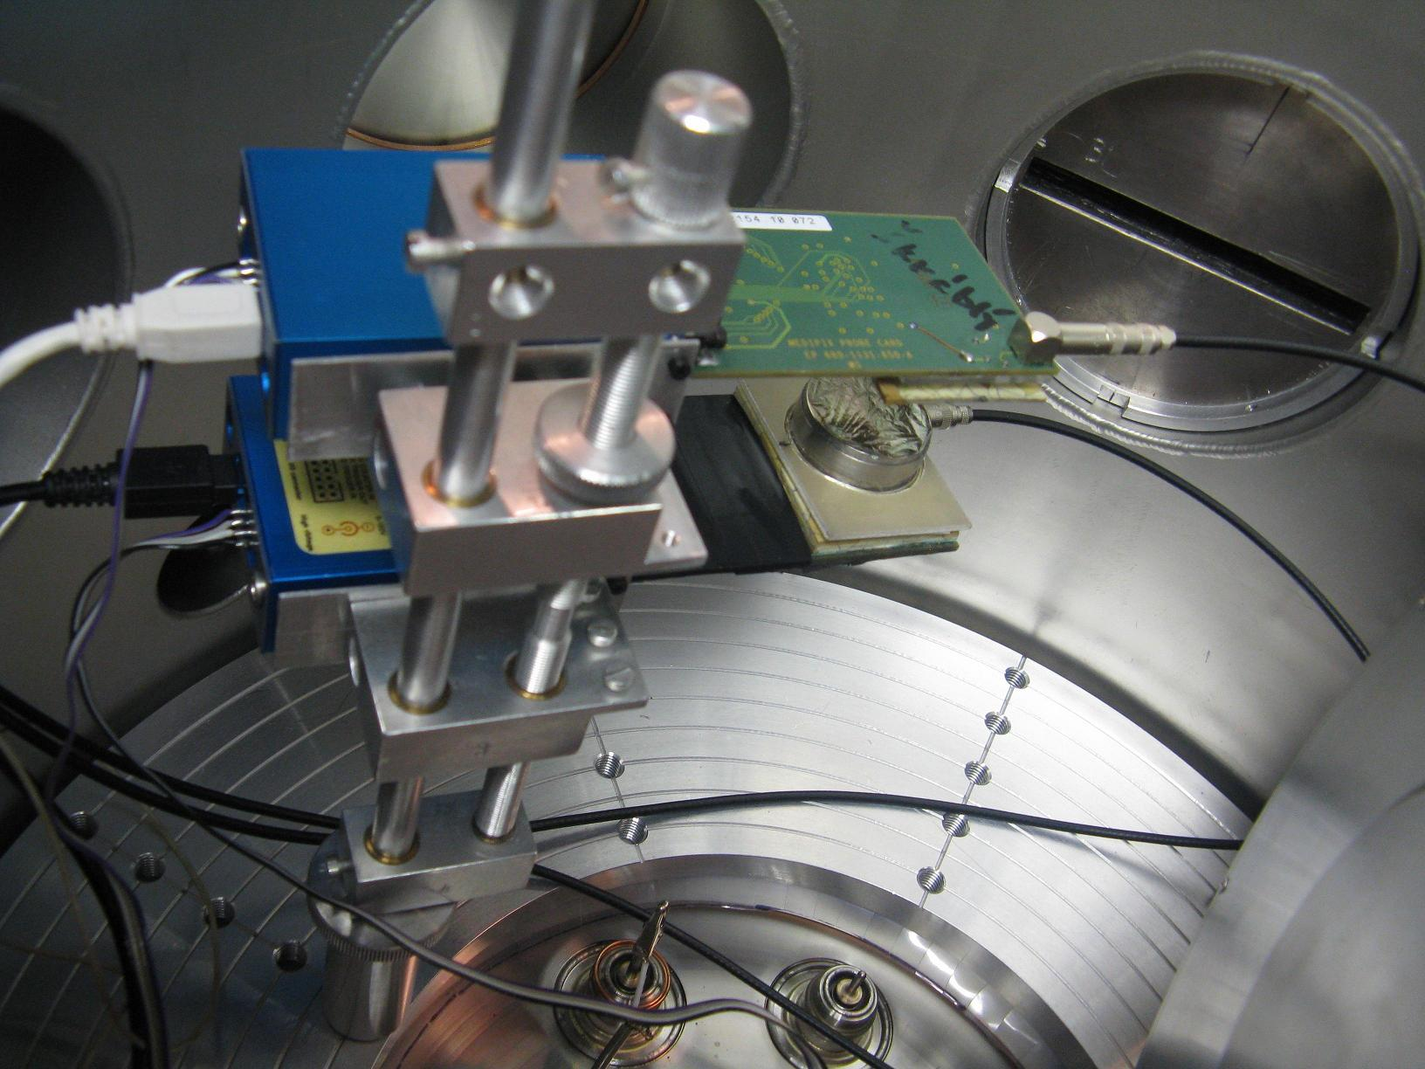
Timepix + th n beam (NPI Řež n. Prague)
two detectors in coincidence
Ext PA+Amp+ADC → trigger
Fission fragment detection
Experimental setup
Principle
USB1.0
TimePix
Neutron beam
TimePix
²³⁵U
target foil
target
Fission event
USB1.0
Medipix2
Medipix2
target : ²³⁵U, ²³⁹Pu

Slide 11
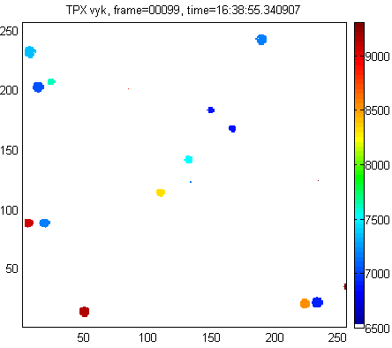
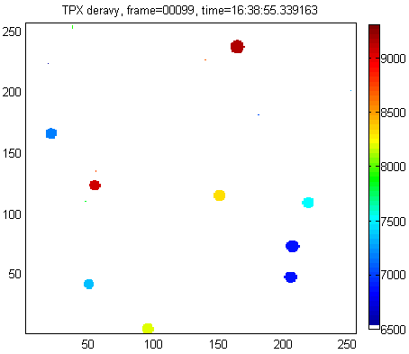
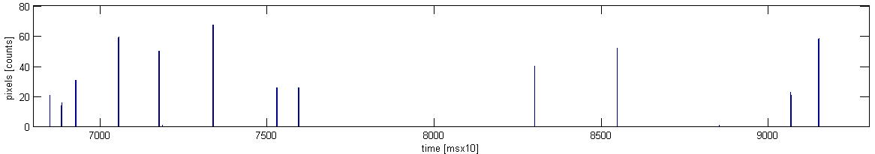
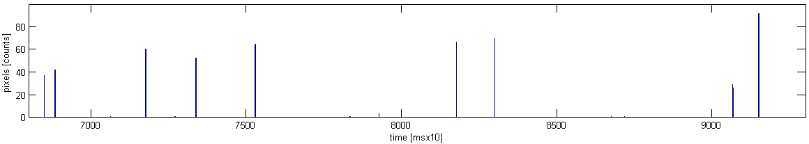
Time stamp + Spatial correlation
A
B
717.5 ms
717.7 ms
759.4 ms
752.9 ms
752.9 ms
717.7 ms
A
759.4 ms
B
Notes:
F_uncal = load(['01 data nb vasek\005_TPXbezSpectrometruNizkeTHLBestSNR_TimepixMode_JenFragmenty\J06-W0082\J06_data_r', e, '_.txt']);

Slide 12
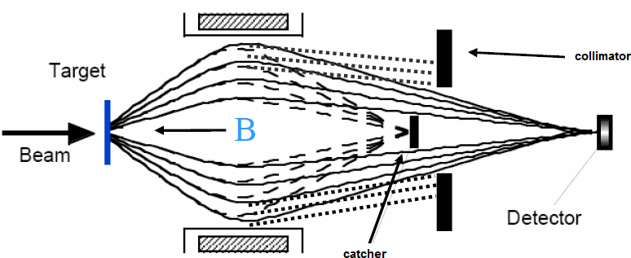
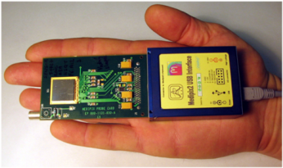
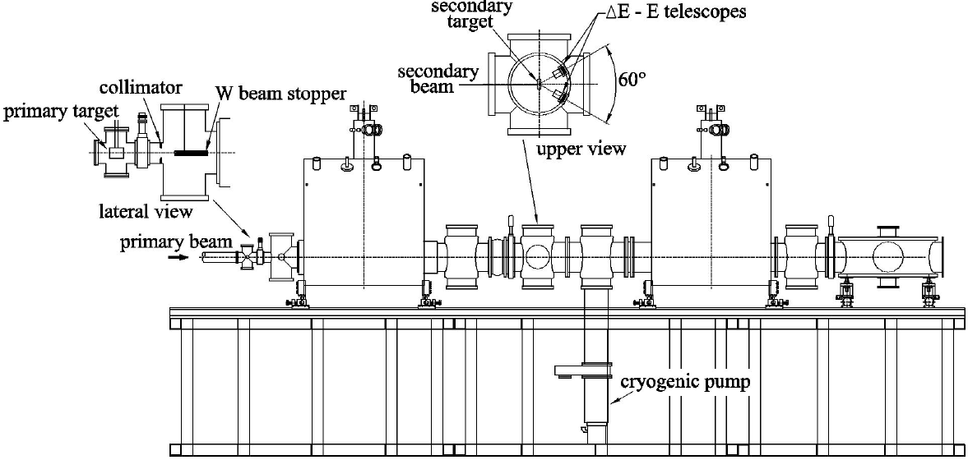
Radioactive ions: RIBRAS Sao Paulo
⁹Be(⁷Li,⁸Li)
Pelletron
8 MeV/u
target
6.5 T SC solenoid
focal spot
6.5 T SC solenoid

Slide 13
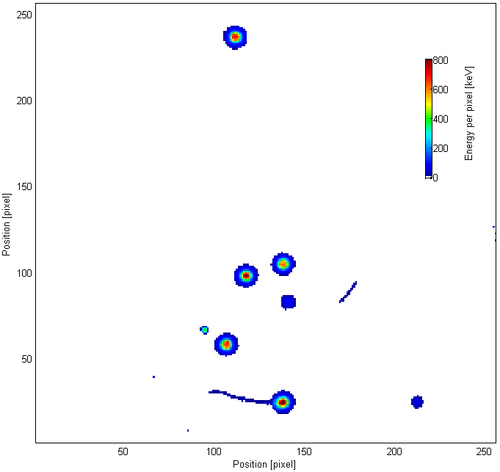
Timepix [TOT] @ focal spot
Position & Energy: Radioactive ions
E = 24.2 MeV
A = 146 px
Characterize the reaction products at focal plane (spot)
E = 22.1 MeV
A = 139 px
E = 2,7 MeV
A = 60 px
E = 23.8 MeV
A = 146 px
E = 312 keV
A = 25 px
E = 3.1 MeV
A = 19 px
E = 22.7 MeV
A = 142 px
E = 1,3 MeV
A = 39 px
E = 28.1 MeV
A = 211 px

Slide 14
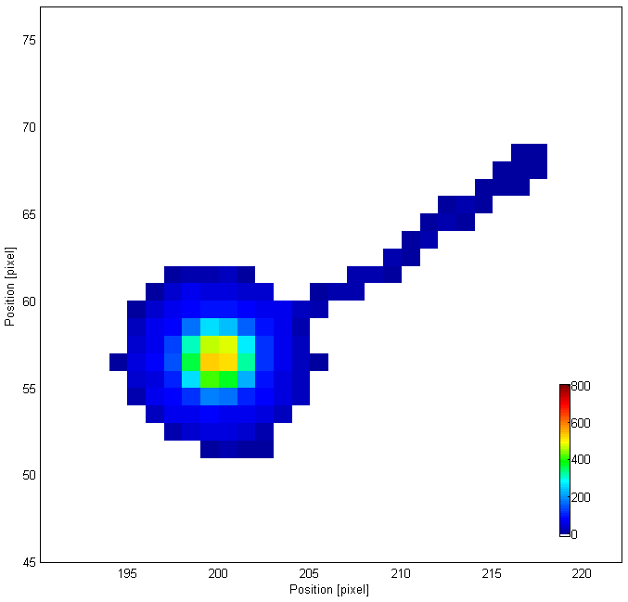
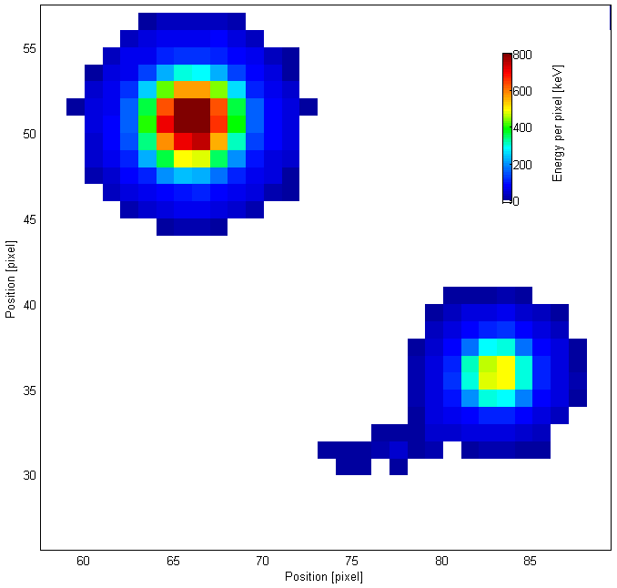
Timepix [TOT] @ focal spot
Position & Energy: Radioactive ions
E = 23.6 MeV
322 keV
E = 8.4 MeV
127 keV
E = 10.1 MeV

Slide 15
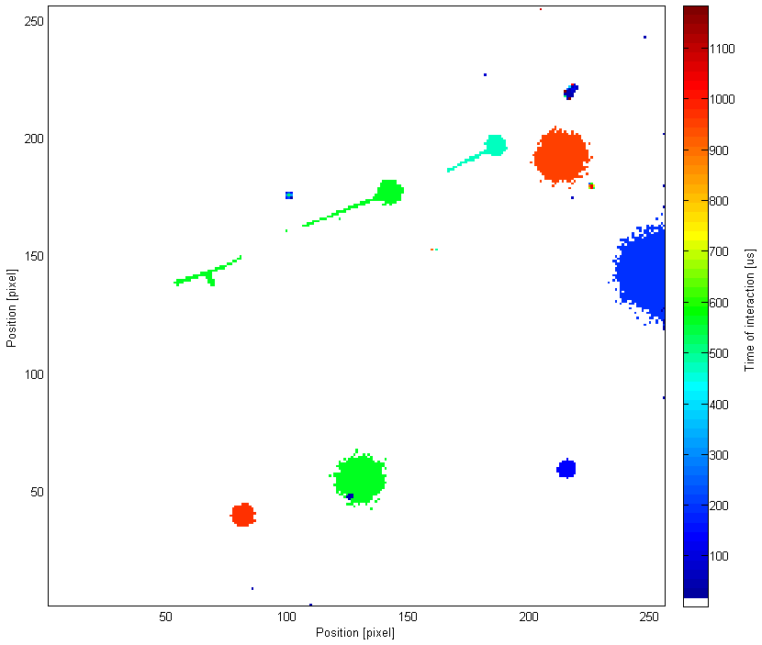
Timepix [TOT] @ focal spot
Position & Time: Radioactive ions
t = 1.2 ms
465 us
949 us
570 us
465 us
570 us
570 us
560 us
972 us

Slide 16
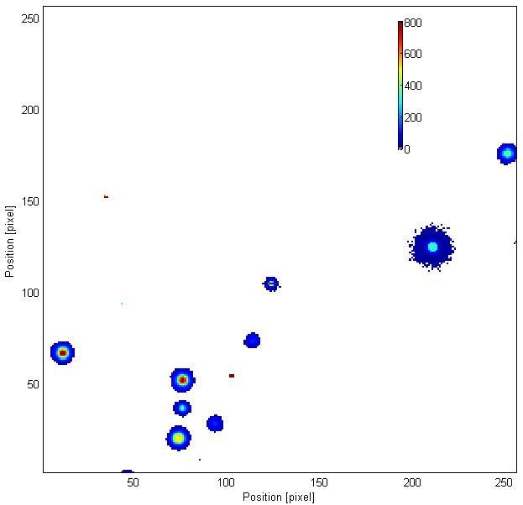
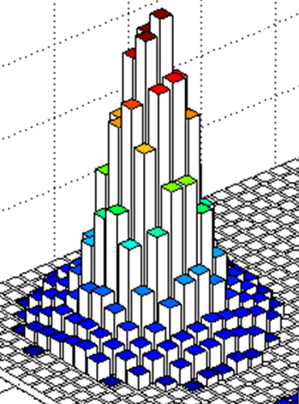
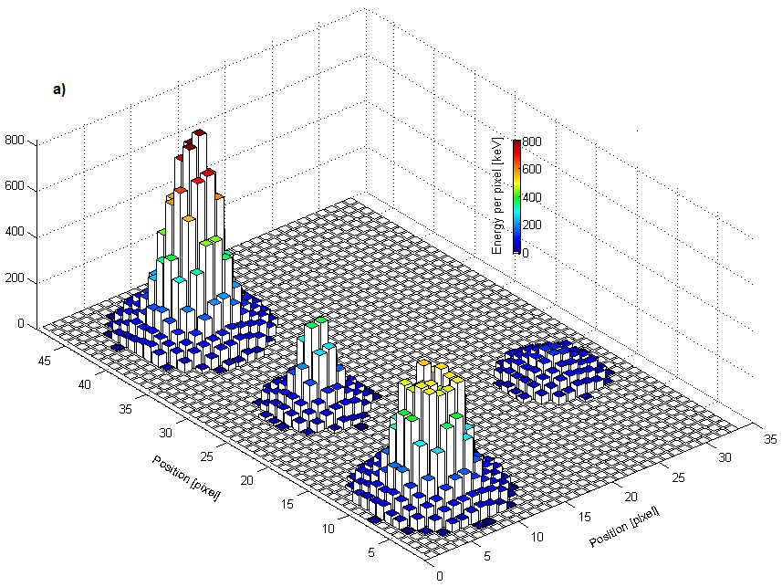
Timepix [TOT] @ focal spot
Position & Energy
A
E
H
E = 11.8 MeV
A = 110 px
C = 380 keV
E = 10.9 MeV
A = 392 px
C = 332 keV
E = 24.4 MeV
A = 137 px
C = 921 keV
E = 5.0 MeV
A = 52 px
C = 1.3 MeV
23.8 MeV
E = 30.7 MeV
A = 147 px
C = 365 keV
PP = 2.6 MeV
5.6 MeV
E = 2.9MeV
A = 62 px
C = 116 keV
3.5 MeV
E = 23.8 MeV
A = 142 px
C = 861 keV
E = 5.6 MeV
A = 71 px
C = 362 keV
E = 9.5MeV
A = 6 px
C = 2.2 MeV
E = 20.8 MeV
A = 141 px
C = 525 keV
E = 3.5MeV
A = 66 px
C = 118 keV
20.8 MeV

Slide 17
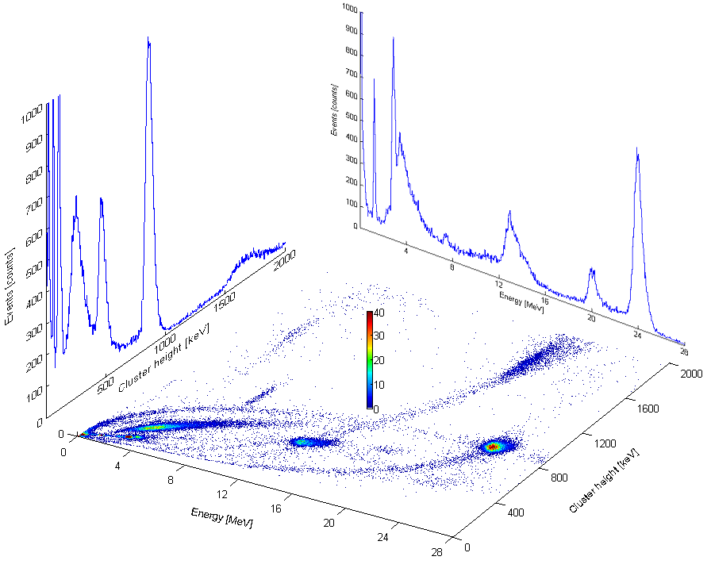
Correlation: Energy vs. Height
H
E

Slide 18
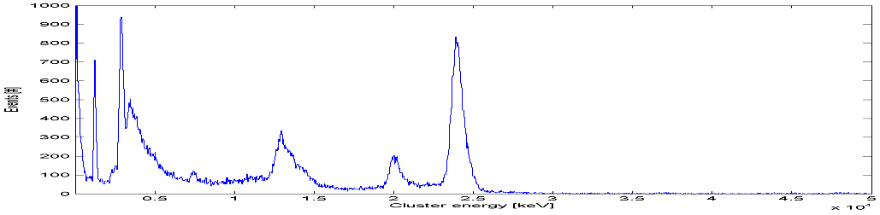
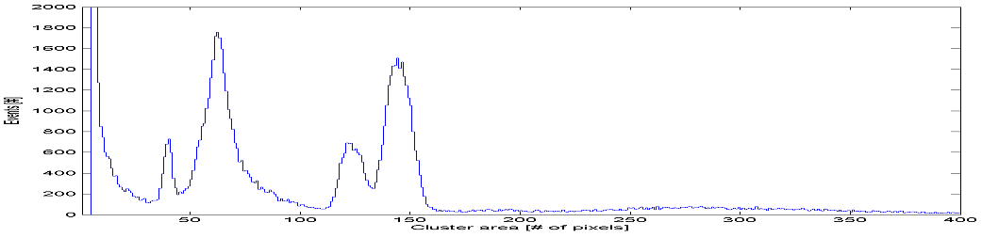
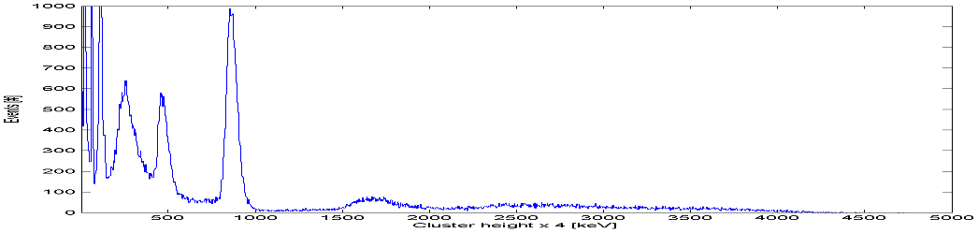
Spectra (Energy, Area, Height)
4
1
6
E
E
5
3
2
4
1
A
A
6
5
3
2
6
1
4
H
3
H
5
2

Slide 19
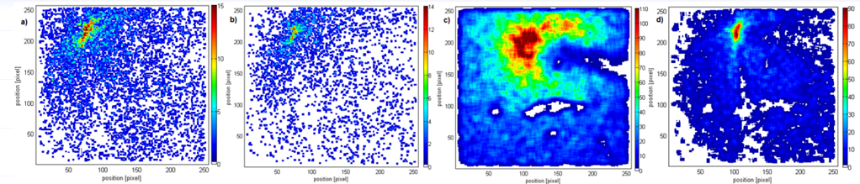
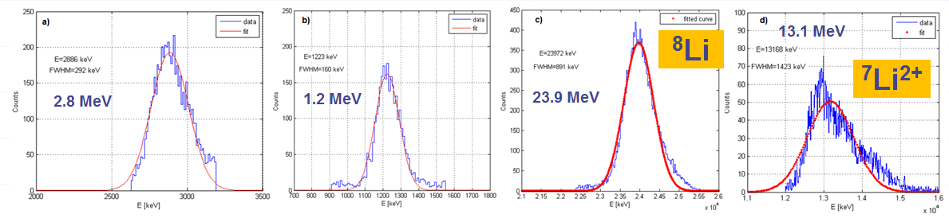
Ion groups: Spectral+ Spatial Distribution
2D spatial image of focal spot ion spatial distribution
Ion group energy spectra
¹H
Tentative ion assignments by the physics (reaction kinematics) and solenoid settings

Slide 20
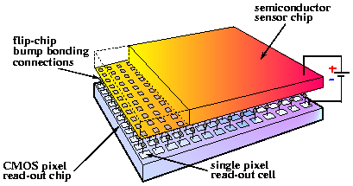
Medipix:
Hybrid semiconductor single particle counting pixel detector
www.cern.ch/medipix
Semiconductor single photon pixel hybrid detector MEDIPIX
α, β, γ
Planar (300, 700, 1000 μm) thick silicon pixel detector (also GaAs, CdTe, or n converter)
Bump-bonded to Medipix readout chip containing amplifier, discriminator and counter for each pixel.
Detector chip
Medipix-2 chip
Bump-bonding
Notes:
The Medipix collaboration involves a number of European Universities and Research Institutes.
The Medipix2 is a second generation of a high spatial, high contrast resolving CMOS pixel read-out chip working in single particle counting mode
It can be combined with different semiconductor sensors which convert the ionizing particle directly into detectable electric signals
High sensitivity, large dynamic range and low contrast detectability, exceeding present charge integrating techniques
No sensitivity to dark currents, allowing for long exposure times under very low intensity illumination (medical applications)

Slide 21
Per–pixel signal electronics
Principle of the hybrid pixel detectors where the sensor chip (top) is bump-bonded to the readout ASIC (bottom). Hybrid technology allows the use of different semiconductor sensors (e.g, Si, CdTe, GaAs) and thickness (e.g. 300, 700, 1000 um). Pulse processing electronics provides simultaneously fast and noise free images.
30 µm
55 µm

Slide 22
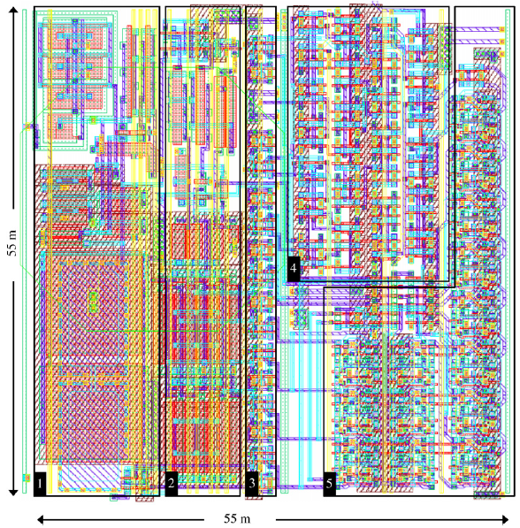
Per–pixel integrated RO signal chain
X. Llopart, et. al. NIM A 581 (2007) 485–494
analogue
digital
Timepix pixel cell layout
Preamplifier
Threshold discriminator with 4-bit threshold equalization
8-bit (PCR) pixel configuration register
Reference clock buffer + (TSL) timepix synchronization logic
14-bit shift register and overflow control logic.
Pixel signal threshold
~ 4 keV
~ 1000 transistors
power consumption ~ 6:5 μW (analogue part)

Slide 23
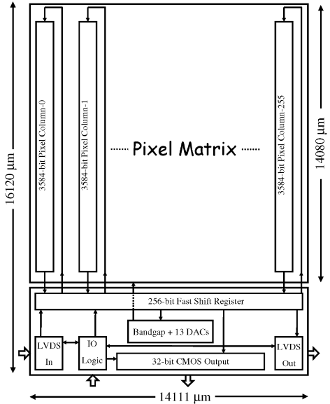
Timepix chip
Chip can be readout with
a 100MHz readout clock:
serially in ≤ 10 ms (LVDS)
in parallel ≤ 300 μs (32-bit CMOS)
Total 36 million transistors
CMOS 0.25 μs technology
Total power consumption
analogue: ~ 440 mW
digital: ~ 450 mW

Slide 24
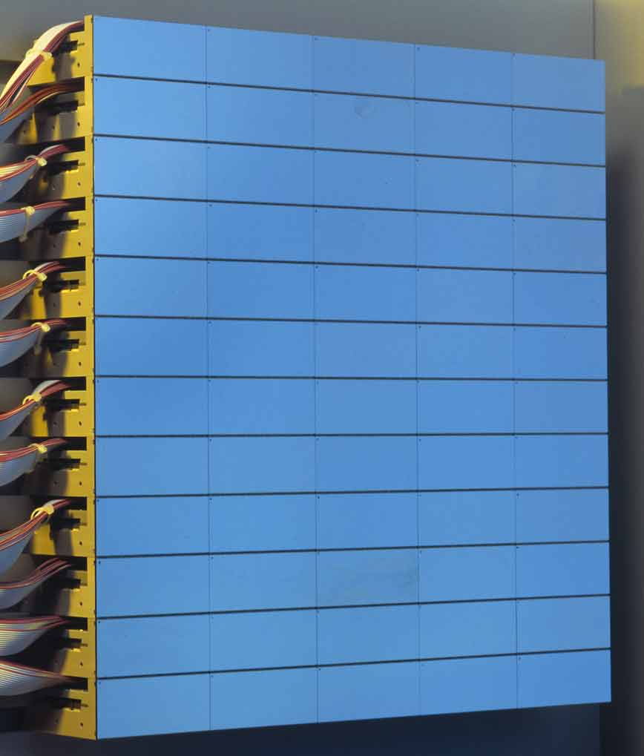
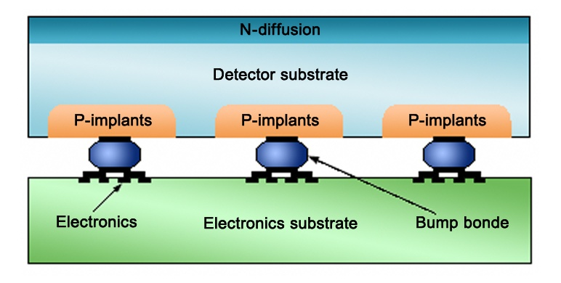
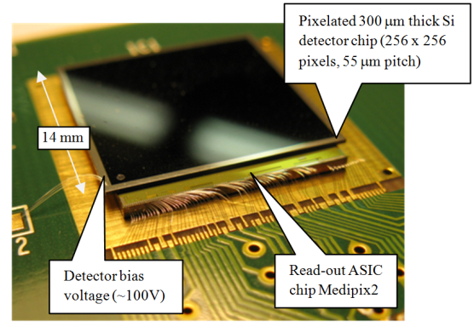
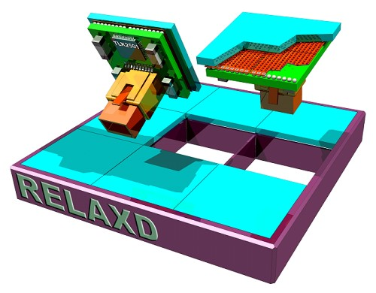
Particle counting pixel detectors
Pilatus - PSI
  60 x 97 pixels
  Pitch of 172 um
  Counter: 20 bits
  Single threshold
  Module: 16 chips (93 kPix)
  Large area - tilling
Medipix2/3 – CERN
  256 x 256 pixels
  Pitch of 55 um
  Two thresholds
  Module: 6 chips (393 kPix)
  Large area: tilling, under
  development (RELAXd)
Timepix - CERN
  The same size as Medipix2
  Time stamp
  Energy measurement in each pixel
Bias Voltage
+
(Si)
Amplifier
Threshold
Level(s)
Compa-
rator(s)
Counter: Particle count
000
001
Pixel electronics
Pixel electronics
Pixel electronics

Slide 25
Direct measurement in each pixel of the particle’s energy or its interaction time.
Timepix detector:
Energy & Time sensitive single particle counting pixel detector
Operation Modes
Time-over-Threshold: TOT
Interaction Time: TimePix
Pixel signal
Pixel signal
Close shutter
A
A
t
t
Clock:
10–80 MHz
Δt
~ E
Clock:
10–80 MHz
Δt
0006
Wilkinson type ADC per pixel
0024
channel ≈ 1 keV
Range: 12 K channels
channel ≥ 100 ns

Slide 26
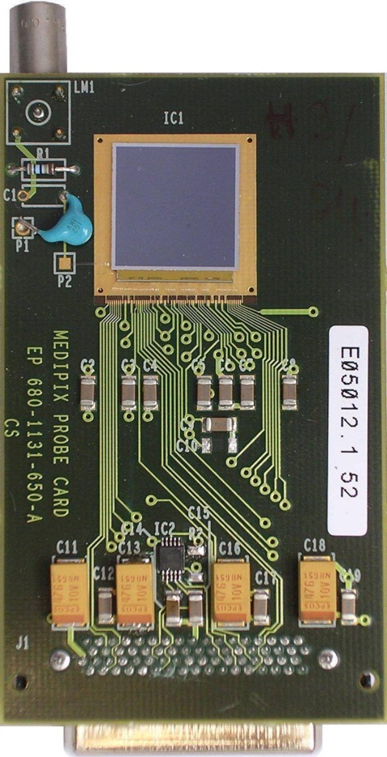
Timepix detector:
Single particle counting pixel detector with per pixel E or T sensitivity
www.cern.ch/medipix
Medipix – MEDical Imaging PIXel detector
Semiconductor pixel hybrid device
High spatial, high contrast resolving CMOS pixel read-out chip
Array of 256x256 = 65 k pixels
Pixel size 55x55 μm²
Sensitive area of 14x14 mm²
Amplifier, discriminator, 13-bit counter in each pixel cell
Pixel clock (10–80 MHz)
Serial or parallel readout at 100MHz
Hybrid technology allows to use different semiconductor sensors
47 mm
Threshold level above
electronic noise
No false counting.
Digital integration (counting)
No dark current.
high signal to noise ratio
wide dynamic range arbitrary exposure time.
79 mm
Notes:
The Medipix collaboration involves a number of European Universities and Research Institutes.
The Medipix2 is a second generation of a high spatial, high contrast resolving CMOS pixel read-out chip working in single particle counting mode
It can be combined with different semiconductor sensors which convert the ionizing particle directly into detectable electric signals
High sensitivity, large dynamic range and low contrast detectability, exceeding present charge integrating techniques
No sensitivity to dark currents, allowing for long exposure times under very low intensity illumination (medical applications)

Slide 27
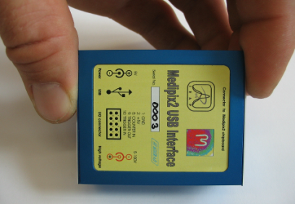
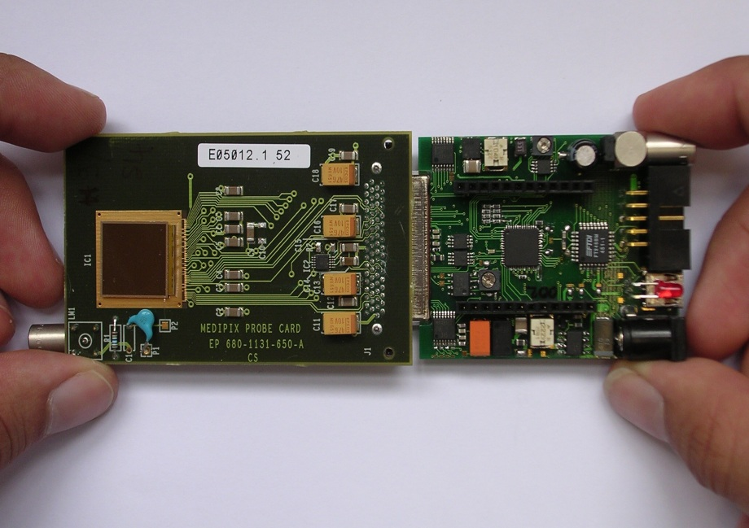
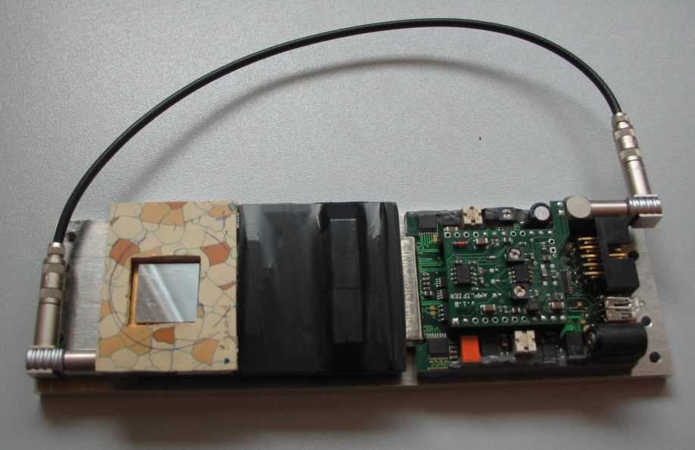
USB readout interface: control, power, DAQ
Z. Vykydal, J. Jakubek, S. Pospisil, NIM A 563 (2006) 112
Compact size, plug and play, hot swap
Fully USB powered
Integrated source of variable detector bias voltage (5 – 100V)
External & internal triggering
and hardware timer
No limit for cable length (tested up to 40 meters!)
Back-side pulse monitoring for spectroscopic applications and triggering
Open system architecture - internal analog and digital interface for "plug-in" PCB modules connection
FITPix – Fast Interface for Timepix Pixel Detectors: FPGA, USB 2.0, 80 fps, V. Kraus et al., J of Instrumentation 6 (2011) C01079

Slide 28
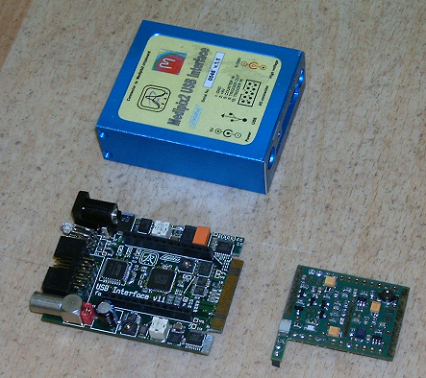
Integrated analog module: fast self trigger

Slide 29
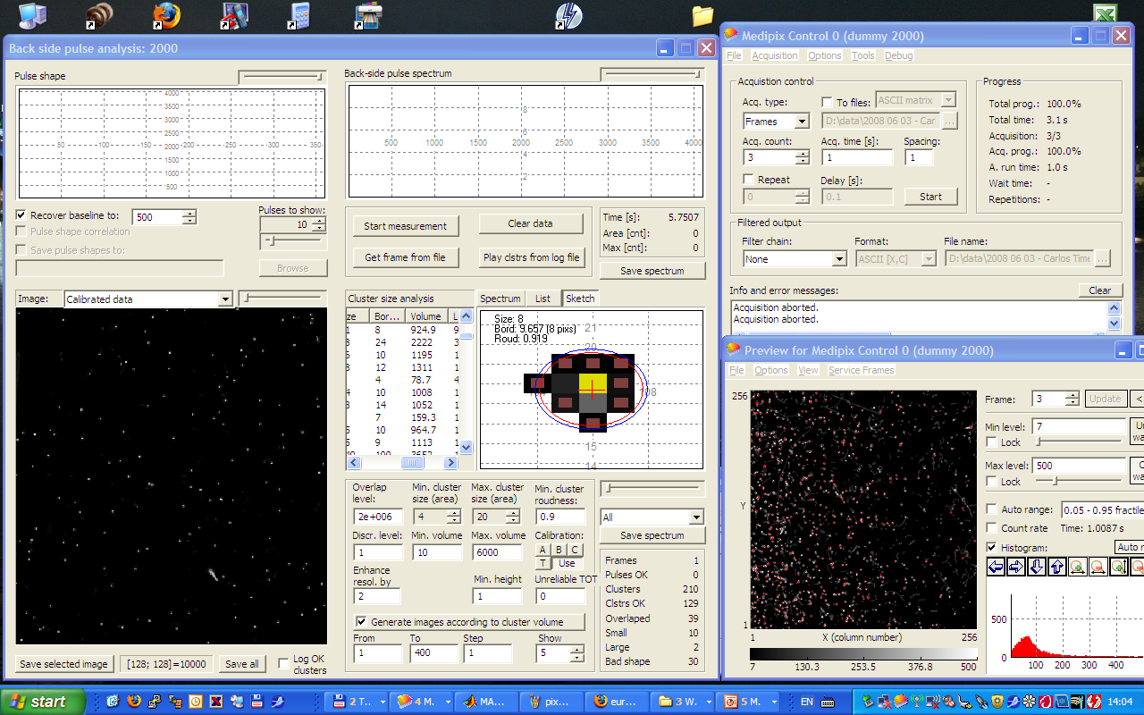
Pixelman:
Data Acquisition and Processing Software Package

Slide 30

TPX + USB RO + Pixelman: Radiation Camera
Selectivity & Sensitivity: enhanced in TimePix (ToT mode)
  Soft X-rays
  MIPS (electrons, muons, π, …)
  Heavy charged particles (p,α,t, ions)
  Neutrons (equipped with converter)
Event by event measurement: single quantum counting
Online visualization & tracking mode spectroscopy
Trigger and coincidence
The device can operate as a multi-radiation camera
Portability & configurability
Zero dark current (no backgrd)
Frame-rate up to 80 fps
Room temperature & noiseless operation
Vacuum operation, no cooling
Plug&Play with any PC

Slide 31
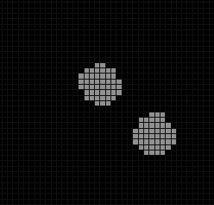
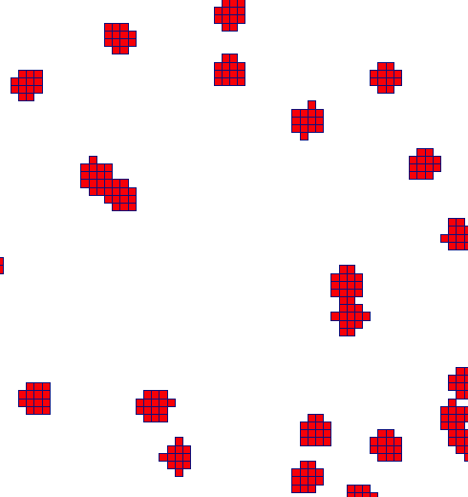

Charge sharing:
Detection of heavy charged particles with pixel detectors
Several adjacent pixels can be incremented when a single particle is detected due to charge diffusion during charge collection.
Pixels incremented by a single particle form a blob (cluster).
α particle
2 detected clusters
Pixel cells
Cluster size up to 90!
Cluster size depends on particle energy
5.4 MeV α source at 24 mm
(measured in air)
Sigma = 1.1
Signal by one
alpha particle
= cluster

Slide 32

TimePix: Heavy Charged Particles
with ²⁵²Cf source @ JINR Dubna
fission
fragment
Energy per pixel [keV]
α
α
α pileup

Slide 33
Timepix:
Detection of Radioactive Ions and their decay
Lohengrin Fission Fragment Mass Separator
Institute Laue Langevin (ILL), Grenoble

Slide 34

Fission: n rich radioactive nuclei
Light fission fragments ²³⁵U(n,f)

Slide 35


Institute Laue Langevin (ILL), Grenoble
Lohengrin Fission Fragment Mass Separator
ΔE + E_{rest ioni chamber}
Reactor active zone
- Flight path ~ 25 m → 2 μs.
p/q
E/q
target
p/q

Slide 36
Institute Laue Langevin (ILL), Grenoble
Lohengrin Fission Fragment Mass Separator
Timepix
ΔE/E gass chamber
Timepix
RED magnet
ILL High Flux
Reactor
HpGe detectors
4 wing diaphragm
Target
RED IN diaphragm
Fissionable targets
(²⁴¹Am, ²³⁹Pu, ²³⁸U, …)
Flexible, wide range,
low-intensity ion source
Fission products are selected according
to A, Z, ionization charge q and kin energy
Broad mass A=1-140 and energy range (4-110 MeV)
Radioactive ion beams
RED IN diaphragm
Condensator
(E field separator)
Main magnet
Flight path ≈ 10m
≈ 3 m
Time of Flight ≈ μs

Slide 37

TPX + Ionization Chamber + Trigger
J. Jakůbek, C. Granja, et al., "Direct Observation of Decay of Radioactive Nuclei with Spatial and Time Coincidence Technique", NIM A 633 (2011) S203-S205
Coincidence system – Selected ions from the ionization chamber are stopped in the Timepix detector where their full energy and subsequent decay are recorded. Gamma rays accompanying the decay are registered by HPGe detectors

Slide 38


TPX + Ionization Chamber + Trigger
Timepix
Segmented ionization chamber

Slide 39


Spatial & Time Detection

Slide 40

Spatial & Time Detection: ⁸He
Time exposure = 4.7s
Time step/channel = 400μs
Time of arrival/
interaction
Time [ms]

Slide 41

Spatial & Time Detection: ⁸He
β– (t = 10.8 ms)
⁸He (t = 0 ms)
Time [ms]
α + α (t = 127.6 ms)
β– (t = 127.6 ms)
1.1 mm

Slide 42

Spatial & Time Detection: ⁸He
Time exposure = 4.7s
Time step/channel = 400μs
Time [ms]

Slide 43

Spatial & Time Detection: ⁸He
Time exposure = 4.7s
Time step/channel = 400μs
t = 0 ms
t = 1423.6 ms
t = 1423.6 ms
t = 656.6 ms
Time [ms]
Time [ms]
1.1 mm

Slide 44





Single ⁸He ion: decay chain sequence
C. Granja, J. Jakůbek, et al., "Spatial and Time Coincidence Detection of the Decay Chain of Short-Lived Radioactive Nuclei", Amer. Insti. of Physics (AIP) Conference Proceedings Series, No. 1265 (2010) 497-500.
TimePix
β⁻
β ⁻
⁸He
⁸Li
⁸Be
α+α
Ion hits the sensor
First β-decay
Subsequent decay of daughter
nucleus by
emission of
one beta
and
two α‘s.
Time = 0
+ 119 ms
+ 840 ms
Pixel signal:
Notes:
44

Slide 45


Spatial & Time Detection

Slide 46
High statistics: integral shutter
[TOT mode + trigger ext clock]
Under high background the Timepix mode (used above) cannot be applied because of pile-ups of other particles hitting the same area in the detector.
The solution is that each pixel is triggered individually in ToT mode
  Timepix is operated in ToT mode (each pixel counts clock pulses if the signal is over the threshold).
  The shutter is opened during all measurement.
  Each incoming ion identified by ΔE/E gas detector generates a trigger signal
  The trigger signal is delayed and used as a clock pulse for Timepix detector.
  The delay is set longer than shaping time of initial pulse from the ion (e.g. ⁹⁸Y) – and therefore this event is not counted.
  If the original nucleus decays in time of clock pulse it is counted in the hit pixel.
  After many such events the complete frame is read-out.
  This frame contains a total number of decays occurring with preselected delay after the given ion (e.g. ⁹⁸Y) detection.
  Changing the delay the decay curve can be measured

Slide 47

High statistics: integral shutter
[TOT mode + trigger ext clock]
Amplitude
Delay > 4 μs
Ion β decay
Trigger
TPX clock
Time

Slide 48

Detection of isomer decay: IC e’s
Detection of internal conversion (IC) electrons
496.2 keV ^{98m}Y
496.2 keV
7.6 μs
⁹⁸Y isomer

Slide 49

495.8 keV ^{98m}Y isomer
495.8 keV ^{98m}Y

Slide 50

495.8 keV ^{98m}Y isomer: T_{1/2}
Decay curve of ⁹⁸Y radioactive ions was measured by scanning altering delay). Decay half-live measured 8 μs. The offset curve denotes the uncorrelated background

Slide 51
Conclusions
Timepix + FITPix + Pixelman:
spectroscopy of implanted radioactive ions
Radiation camera as active nuclear emulsion
  Particle tracking & online visualization
RI & charged particle decay: techniques
  Low background
  High background
Suppression of unwanted events/background
  (high selectivity, background suppression >10⁴)
Position and time correlated technique
  register charged particle decay radiation
  measure decay times in range μs–s (and longer)
  registration of sequential decay chain
  techniques demonstrated (⁸He, ^{98m}Y)

Slide 52



Acknowledgments
Stanislav Pospíšil, Jan Jakůbek
Michal Platkevic
Institute of Experimental and Applied Physics
Czech Technical University in Prague
Ulli Köster
Institute Laue-Langevin (ILL)
Grenoble, France
500 μm
CERN Medipix Collaboration
www.utef.cvut.cz/medipix
www.cern.ch/medipix
www.ill.eu

Slide 54
Direct measurement in each pixel of the particle’s energy or its interaction time.
Hybrid Semiconductor Pixel Detector
Single particle counting pixel detector + POS + E + T sensitive
www.cern.ch/medipix
N⁺
P⁺
Threshold level above
electronic noise
No false counting.
Digital integration (counting)
No dark current.
Wide dynamic range, arbitrary exposure time.
Si
+
Bias Voltage
clock
Amplifier
Common
back-side
electrode
Pixelated
front-side
electrode
Compa
rator
Counter: Clock oscillat
Threshold
level
000
0006
Wilkinson type ADC per pixel
Pixel electronics
Notes:
The Medipix collaboration involves a number of European Universities and Research Institutes.
The Medipix2 is a second generation of a high spatial, high contrast resolving CMOS pixel read-out chip working in single particle counting mode
It can be combined with different semiconductor sensors which convert the ionizing particle directly into detectable electric signals
High sensitivity, large dynamic range and low contrast detectability, exceeding present charge integrating techniques
No sensitivity to dark currents, allowing for long exposure times under very low intensity illumination (medical applications)

